Slide 1
NAME-338 Ship Design Project & Presentation
Supervised by,
Dr. N. M. Golam Zakaria
Professor,
Dept. of NAME,
BUET.
Presented by,
Touseef Hasan
Student ID: 1812044,
Mehedi Hasan
Student ID: 1712046.

Slide 2
Owner’s Requirements
Vessel Type: Bulk Carrier
Capacity: 2300 tonnes
Service Speed: 10 knots
Route: Dhaka – Chittagong (Inland)
Route Distance: 315 km (171 nautical miles)

Slide 3
List of Contents
Principal Particulars
Preliminary Lightweight, Deadweight and
Displacement Calculation
Preliminary General Arrangement
Preliminary Lines Plan
Preliminary Hydrostatic Calculation

Slide 4
Principal Particulars of Basis Ship
Length Overall
Length between Perpendiculars
Breadth Mld.
Depth Mld.
Draft
Engine Power
Service Speed
CB
CD
: 63.2 m
: 61.5 m
: 10.2 m
: 4.6 m
: 3.5 m
: 522*2 KW
: 10 knots
: 0.79
: 0.76

Slide 5
Calculation from Basis Ship
L/B = 6.02
B/D = 2.21
B/T = 2.91
∇ = 1734. 48 tonnes
DWT = 1318.21 tonnes
Admiralty Coefficient = 185.35

Slide 6
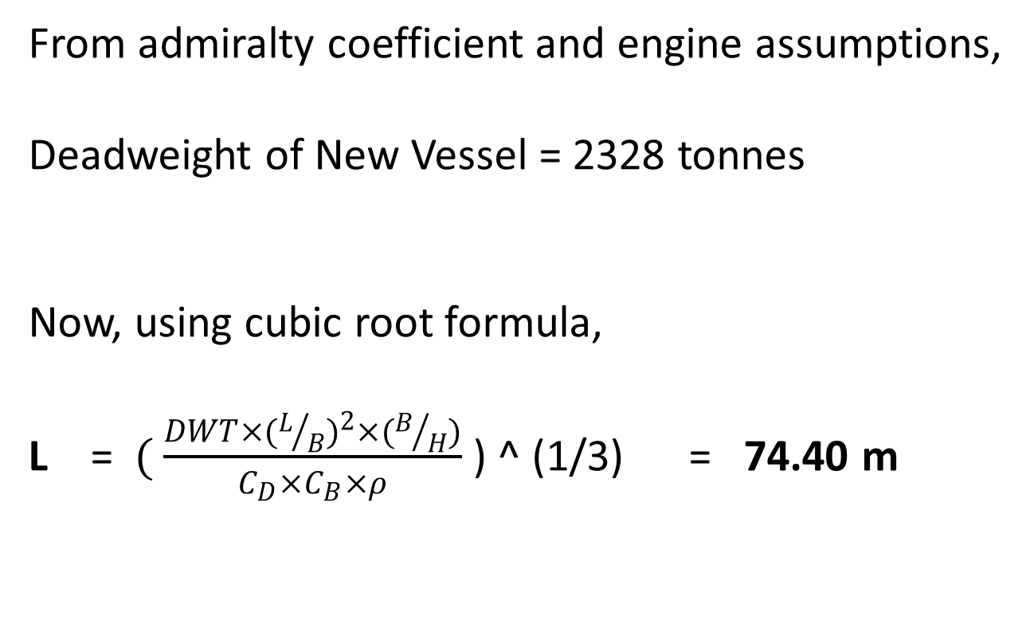
Determining Principal Particulars
From admiralty coefficient and engine assumptions,
Deadweight of New Vessel = 2328 tonnes
Now, using cubic root formula,
L =$( \frac{DWT×{(L/B)}^{2}×(B/H)}{C_{D}×C_{B}×ρ}$ ) ^ (1/3) = 74.40 m

Slide 7
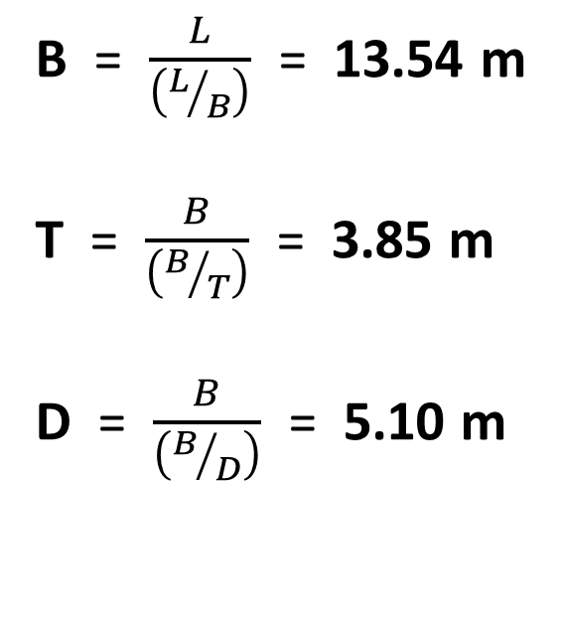
Determining Principal Particulars (cont.)
B = $\frac{L}{\left(L/B\right)}$ = 13.54 m
T = $\frac{B}{\left(B/T\right)}$ = 3.85 m
D = $\frac{B}{\left(B/D\right)}$ = 5.10 m

Slide 8
Final Principal Particulars
Length Overall
Length between Perpendiculars
Breadth Mld.
Depth Mld.
Draft
Service Speed
CB
: 76.4 m
: 74.4 m
: 13.54 m
: 5.1 m
: 3.85 m
: 10 knots
: 0.79

Slide 9
Manning
Master | (Class 1) | 1
 | (Class 2) | 1
Sailor |  | 8
Driver | (Class 1) | 1
 | (Class 2) | 1
Geezer |  | 3
Total Crew: |  | 15

Slide 10
Deadweight Assumptions
& Lightweight, Displacement Calculations
Bulk Capacity = 2300 tonnes
Incorporating fuel weight, crew weight, fresh water, etc.
Deadweight = 2328 tonnes
Displacement = 3063 tonnes
Lightweight = ∇ - DWT = 735 tonnes

Slide 11
General Arrangement Drawing

Slide 12
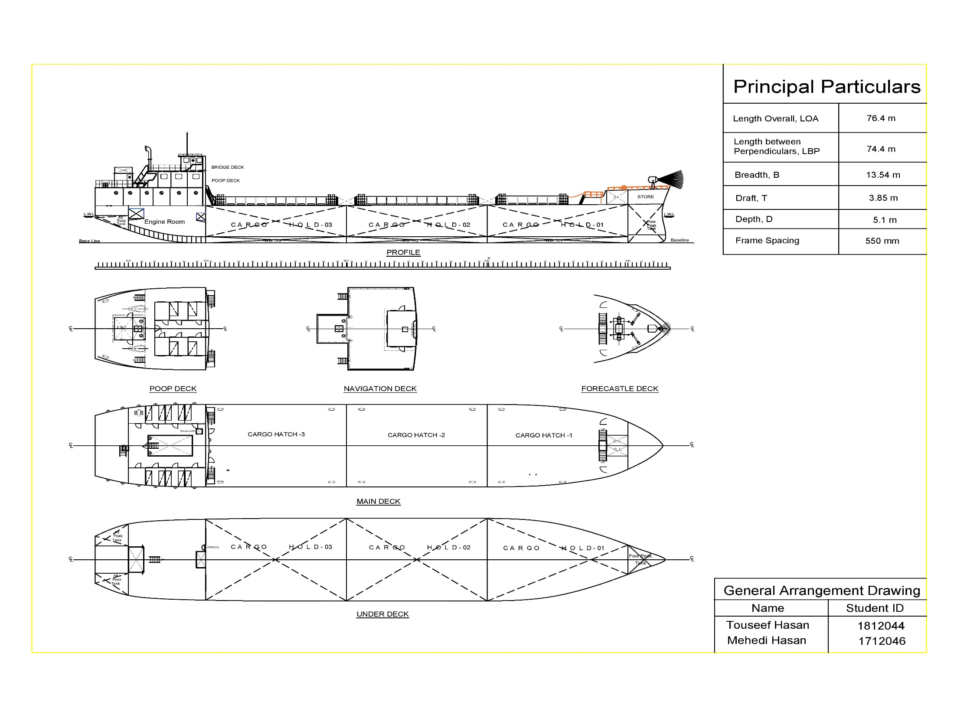

Slide 13
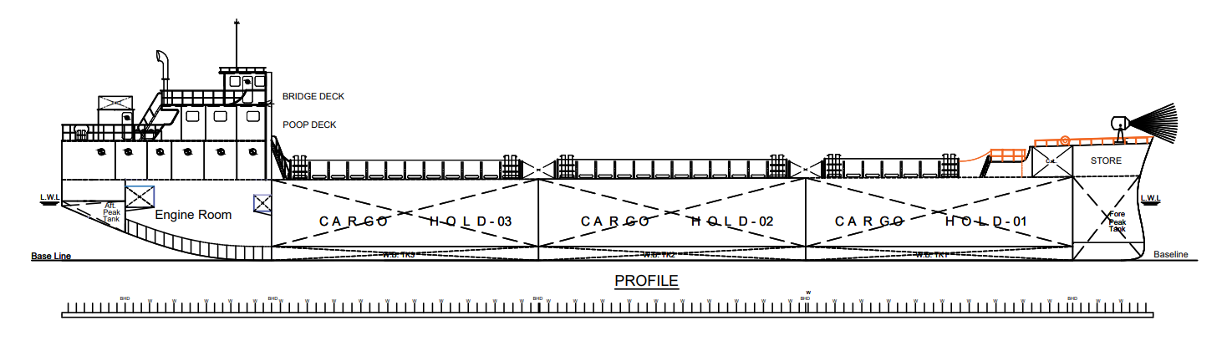

Slide 14
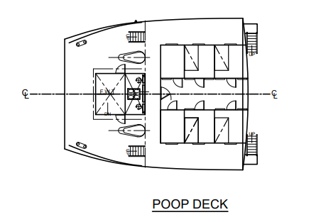

Slide 15
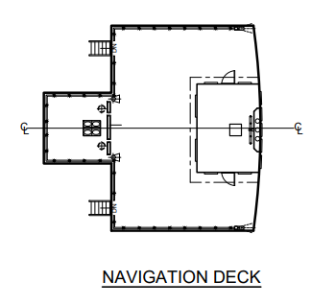

Slide 16
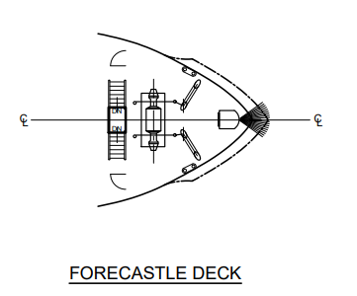

Slide 17
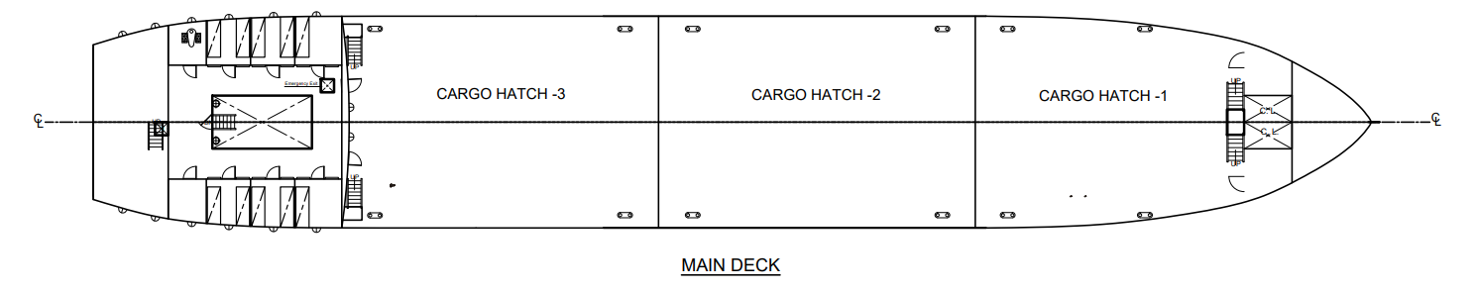

Slide 18
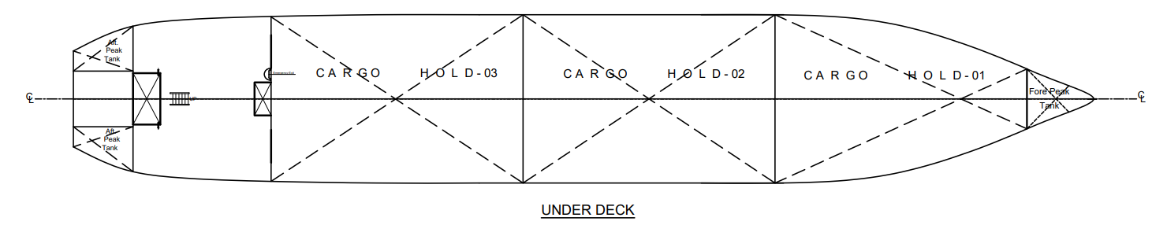

Slide 19
Lines Plan

Slide 20
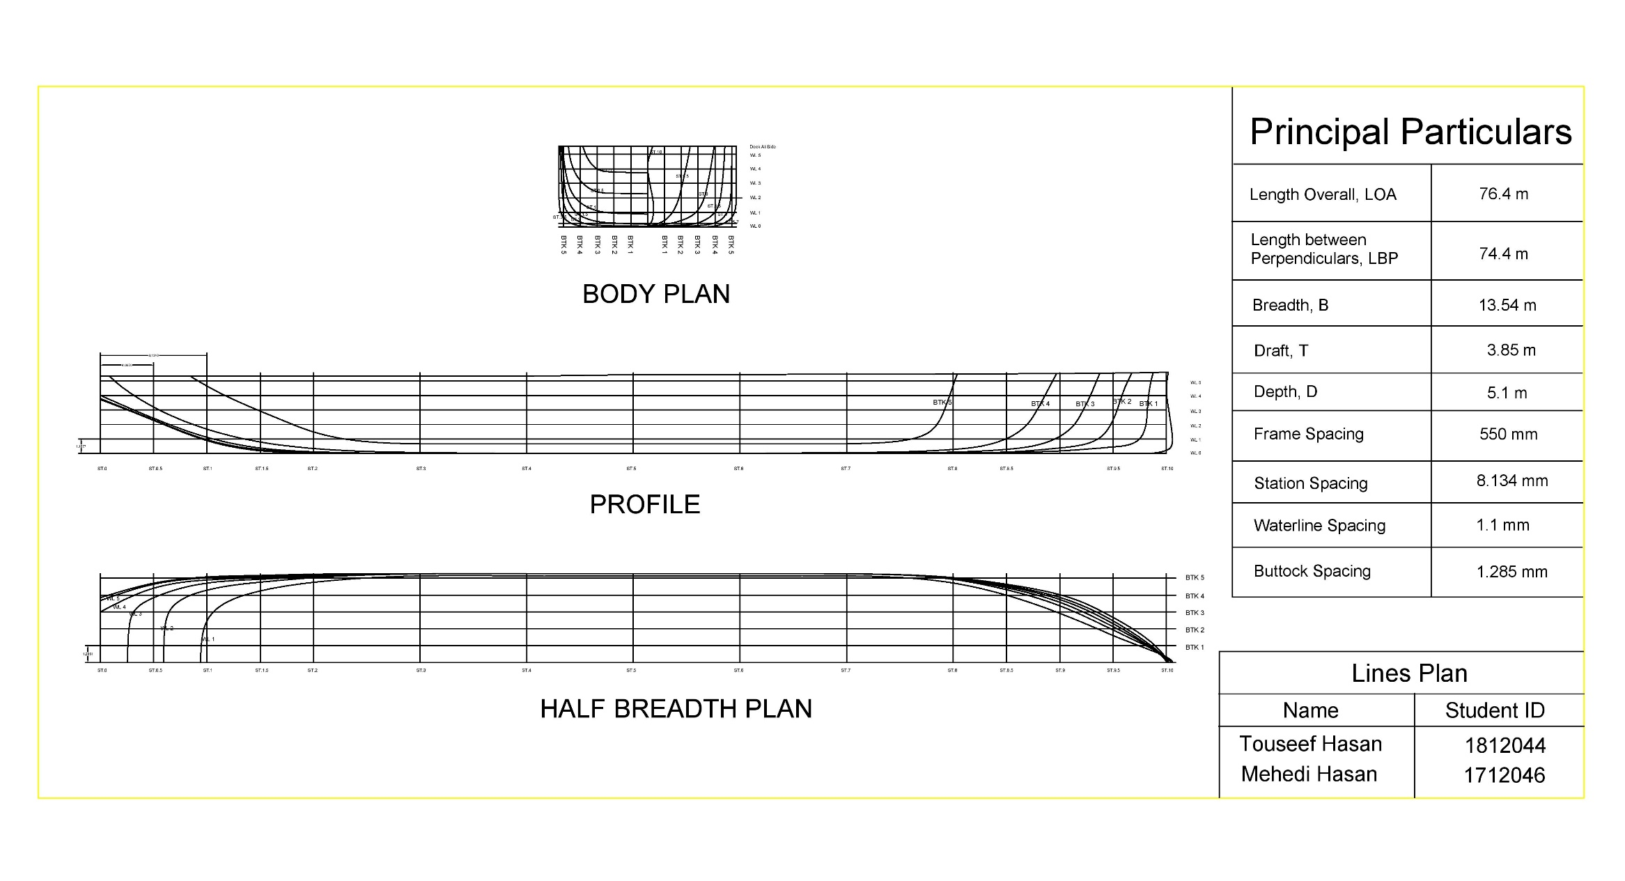

Slide 21
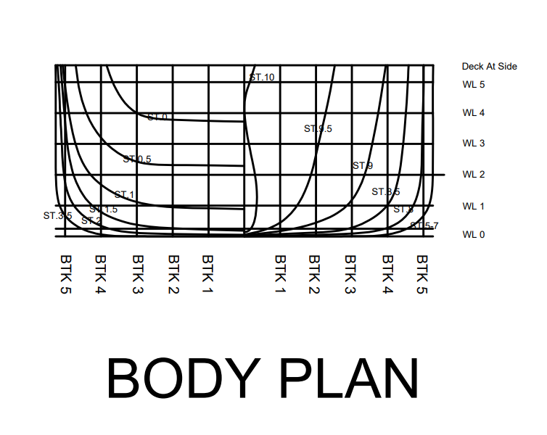

Slide 22
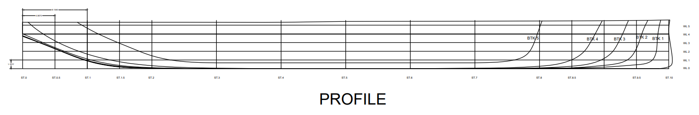

Slide 23
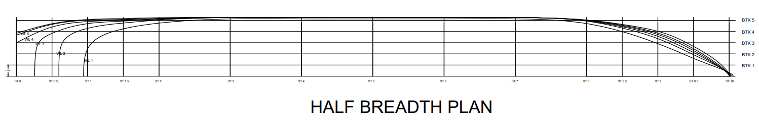

Slide 24
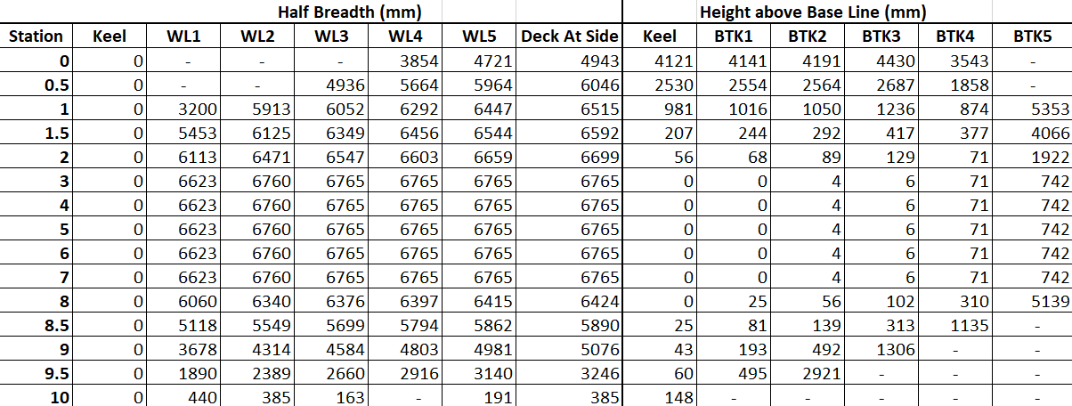
Offset Table

Slide 25
Offset Table (cont.)
Waterline Spacing = 1.1 m
Station Spacing = 8.134 m
Buttock Spacing = 1.285 m

Slide 26
Hydrostatic Parameters
Displacement
Vertical Centre of Buoyancy, VCB
Longitudinal Centre of Buoyancy, LCB
Tonnes per cm Immersion, TPC
BMT
BML
Longitudinal Centre of Flotation, LCF
Moment to Change Trim 1 cm, MCTC
Block Coefficient, CB
Prismatic Coefficient, CP
Midship Section Coefficient, CM
KML
KMT
Waterplane Area, WPA

Slide 27
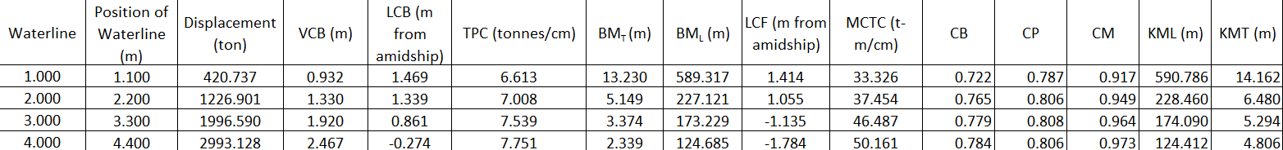
Summary of Hydrostatic Calculation

Slide 28
Individual Hydrostatic Curves

Slide 29
Individual Hydrostatic Curves (cont.)

Slide 30
Individual Hydrostatic Curves (cont.)

Slide 31
Individual Hydrostatic Curves (cont.)

Slide 32
Individual Hydrostatic Curves (cont.)

Slide 33
Individual Hydrostatic Curves (cont.)

Slide 34
Individual Hydrostatic Curves (cont.)

Slide 35
Hydrostatic Curves
VCB

Slide 36
Thank You.

